Slide 1
Head of College
Mrs Brown
Assistant Head of College
Miss Field
Form Tutors
Mrs Palin
Mr Smith
Mrs Farrin
Ms Hart
Mrs Rowe / Mrs Scott
Ms Casey
Mrs Allen Wood
Head of College
Mrs Carter
Assistant Head of College
Mr Harris
Form Tutors
Mrs Perez Alonzo
Miss Ahmed
Miss Biggar
Ms Maynard
Miss Roffe
Mr Franklin
Mr Mendlesohn
Head of College
Miss Cowling
Assistant Head of College
Miss Clark
Form Tutors
Miss Campion
Mr Goodman
Miss Dinnegan
Mr Brown
Ms Woodard
Miss Chambers
Mrs Hassan

Slide 2
Staff contact
All pastoral communication to:
middlepastoral@barnwell.herts.sch.uk
This email account is monitored and your query or concern will be forwarded to the most relevant member of staff. Staff aim to reply to parents within 24 hours.

Slide 3
3 Step Plan
Reminder
Concern
Detention

Slide 4
Behaviour Concerns
Standards – 30 minute detention. Combined and sat on a Friday afterschool
Low Level Disruption – 45 minute detention
Persistent Low Level Disruption- 60 minute detention
Friday extended detention- Between 3pm-6pm
Isolations – Completed on the Upper Campus from 8:30am-4pm
Exclusions

Slide 5
REWARDS
College Points
PRIDE Points

Slide 6
PRIDE
Passionate
Resilient
Innovative
Determined
Empathetic

Slide 7
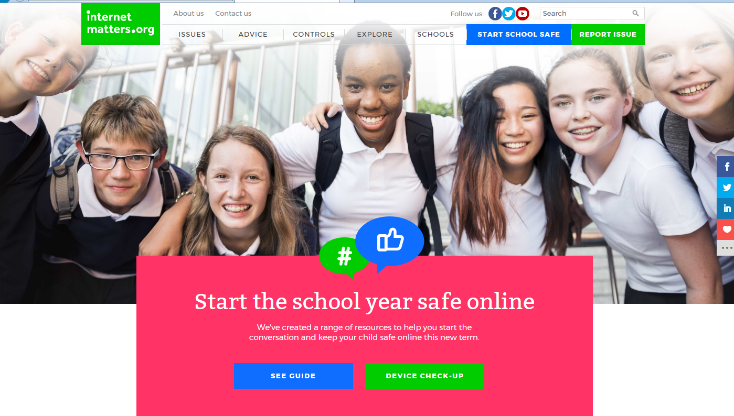
How can you help at home?
https://www.internetmatters.org/

Slide 8
Further Support
There may be times when students need external support to help with issues in or outside of school. At Barnwell we pride ourselves on our student focussed approach and have a variety of agencies that support the school.
If students cannot be supported in school, we are able to refer to more appropriate agencies. Please contact the pastoral team if additional support is required.
Under the ‘parent support’ section of the school website, you can also find lots of helpful guides ranging from social media to anxiety and exam stress.

