Slide 1
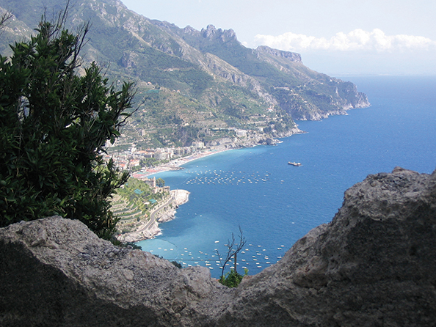
Food Technology trip to the Bay of Naples, Italy – April 2019

Slide 2
Contents
About Us
Your Destination
Itinerary & Accommodation
The Tour Aims & Benefits
Important information
Behaviour expectations

Slide 3
About us
Our
Experience
Over 30 years experience in the educational travel industry with over 20,000 students traveling with us every year
We provide safe, high-quality, competitively priced tours that support classroom learning and we’re here to help group leaders tackle all the practicalities of taking a group away
Our
Passion
We share your passion for your subject. Most of us at Travelbound are experts in one or more subject fields, fluent in more than one language and have travelled extensively
This mix of on-the-ground knowledge and subject expertise means we know how to make the most out of every step of your school trip
Our
Protection
As part of Travelopia, we offer the highest level of financial protection. Our global presence ensures that we have a year-round worldwide support network
We are proud to have been awarded full accreditation for the LOtC Quality Badge scheme, are a full member of the School Travel Forum and fully bonded by ABTA and ATOL

Slide 4
Contents
About Us
Your Destination
Itinerary & Accommodation
The Tour Aims & Benefits
Important information
Behaviour expectations

Slide 5
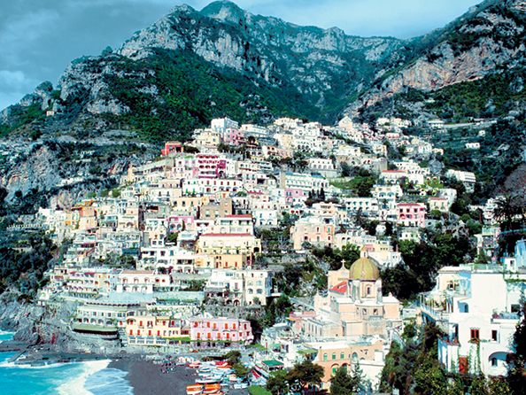
About Your Destination
Map of the country / city
Information
Country / City
The Bay of Naples is one of Italy’s most popular tourist destinations for its beauty, culture, history and food.
Many school groups visit every year to visit the dormant Mt Vesuvius and the towns of Pompeii and Herculaneum which it destroyed in AD79.
Naples is famed for its art and gastronomy too and is the birthplace of the iconic Italian pizza!

Slide 6
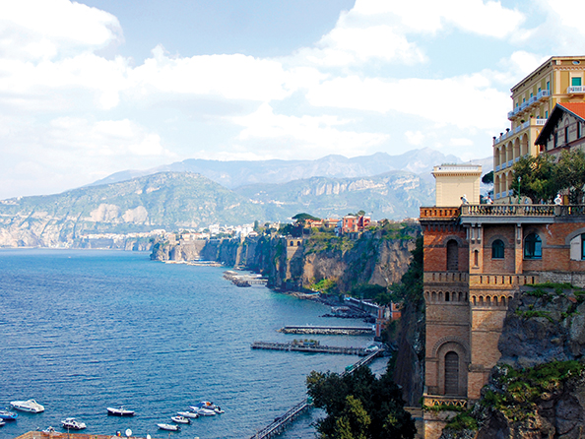
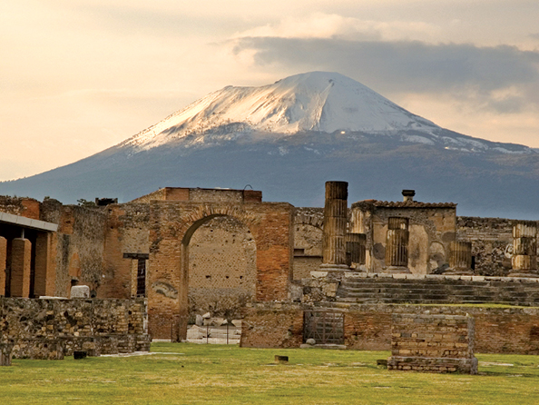
About Your Destination
Images the Bay of Naples and Pompei

Slide 7
Contents
About Us
Your Destination
Itinerary & Accommodation
Tour Aims & Benefits
Important information
Behaviour expectations

Slide 8
Barnwell School Itinerary - 8th April – 11th April 2019
Day 1
0600hrs Flight from Stansted (Meet at Old Red lion 0200hrs)
Mozzarella farm, demo and lunch
Day 2
Breakfast at accommodation
Pompei
Day 3
Breakfast at accommodation
Olive oil demonstration
Day 4
Accommodation and dinner
Gnocchi and Struffoli cookery class
Dinner at accommodation
Free Time
Restaurant for pizza making and dinner
Breakfast at accommodation
Flight back to Luton 12.25

Slide 9
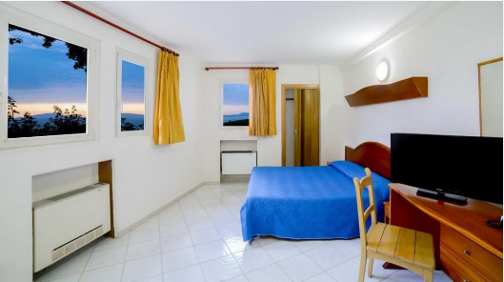
Accommodation
Accommodation
La Ripetta Hotel
Why we like it for student groups
this property is 6 minutes walk from the beach
900 yards from the Circumvesuviana Train Station
the restaurant serves a combination of international food and specialities from the Campania region
Facilities
rooftop terrace with sea views
private bathrooms
air conditioning
free wi-fi
Address
Via Ripa Di Cassano 4, 80063 Piano di Sorrento, Italy

Slide 11
Contents
About Us
Your Destination
Sample Itinerary & Accommodation
Tour Aims & Benefits
Important information
Behaviour expectations

Slide 12
Aims & Benefits
Aim of Trip
Benefit of Trip
learn about traditional Italian cuisine
visit local producers and understand the manufacturing processes
understand the reasons why the soil in this region is so fertile
learn how to prepare Italian food by assisting a chef
understand the importance of cooking within different cultures
test and challenge their own cooking abilities
learn more about Italian food, cooking techniques and culture
make the connection with local produce and regional specialities
study how climate and topography affect agriculture
gain practical skills that can be used in the UK

Slide 13
Contents
About Us
Your Destination
Sample Itinerary & Accommodation
Tour Aims & Benefits
Important information
Behaviour expectations

Slide 14
Trip Resources
Important Information
Hand luggage only - 56x45x25cm (including handles and wheels)
Do not forget a Name Tag for your hand luggage)
You can only carry liquids, aerosols and gels in containers of 100ml or less, up to a combined maximum of 1000 ml, These should all fit into one transparent, re-sealable 20x20cm bag.
Weather should be around 20 degrees, so pack accordingly and appropriately.
Light rain jacket, fleece, comfortable walking shoes, t shirts. And sweat tops.
Sunglasses and a hat
Water bottle
Spending money – Max £60
Small backpack for day trips
Mobile phones – at appropriate times and at own risk
Lanyards will be handed out to students and must be worn at all times.

Slide 15
Contents
About Us
Your Destination
Sample Itinerary & Accommodation
Tour Aims & Benefits
Important information
Behaviour expectations

Slide 16
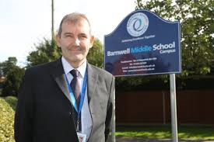
Behaviour and expectations

Slide 17
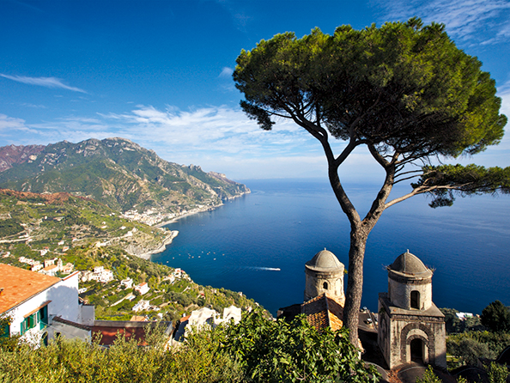
Enjoy your trip… Any questions?

