Slide 1
Reflections
3: Lockdown

Slide 2
The government have asked us to lockdown so that we can help save lives.
How will this be possible?

Slide 3
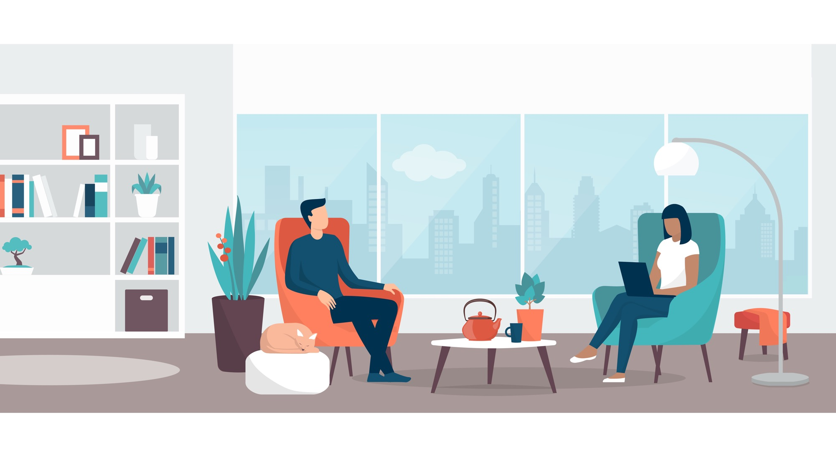
Well, if we stay inside then we won’t spread any virus if we’ve picked it up. It’s likely that most people will recover if they pick up the virus but many people who have existing health conditions may not. We are doing what we can, to save others.

Slide 4
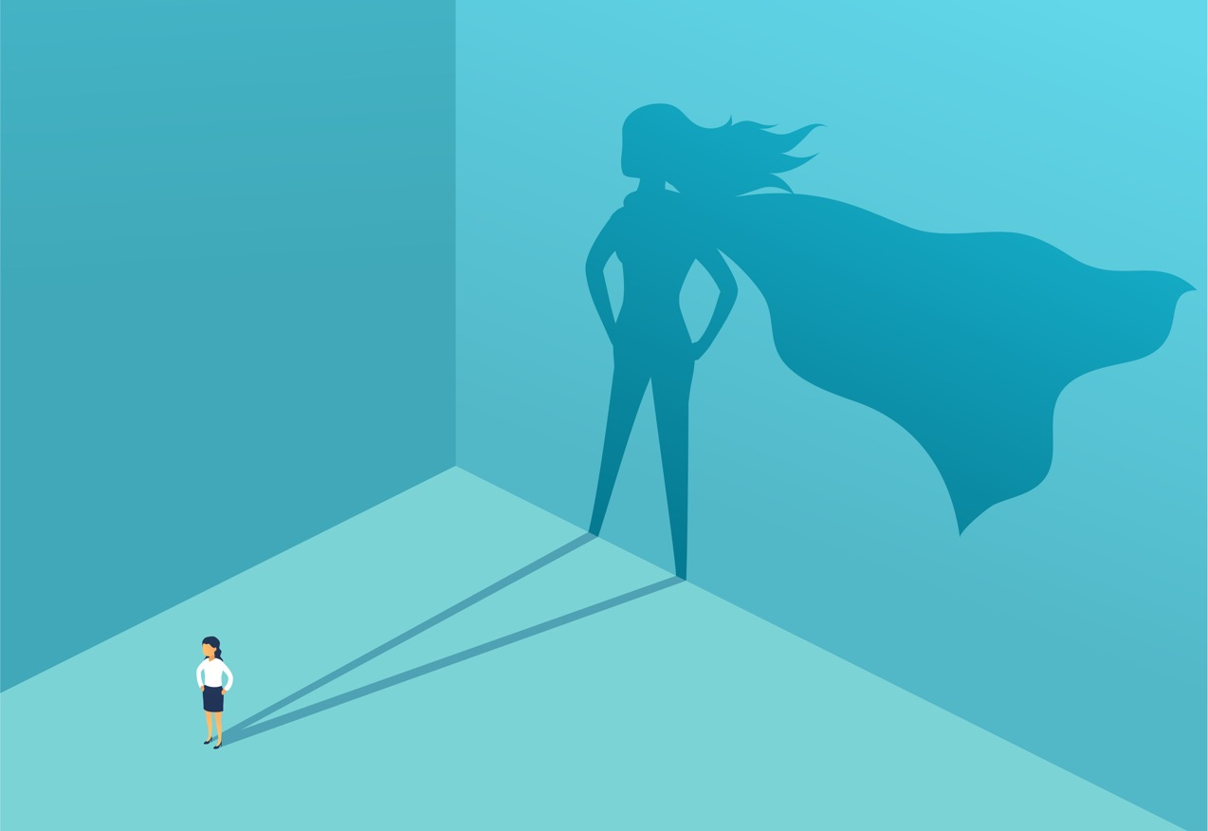
All of us get our chance to be everyday heroes.

Slide 5
If we all play our part, we can make a difference.

Slide 6
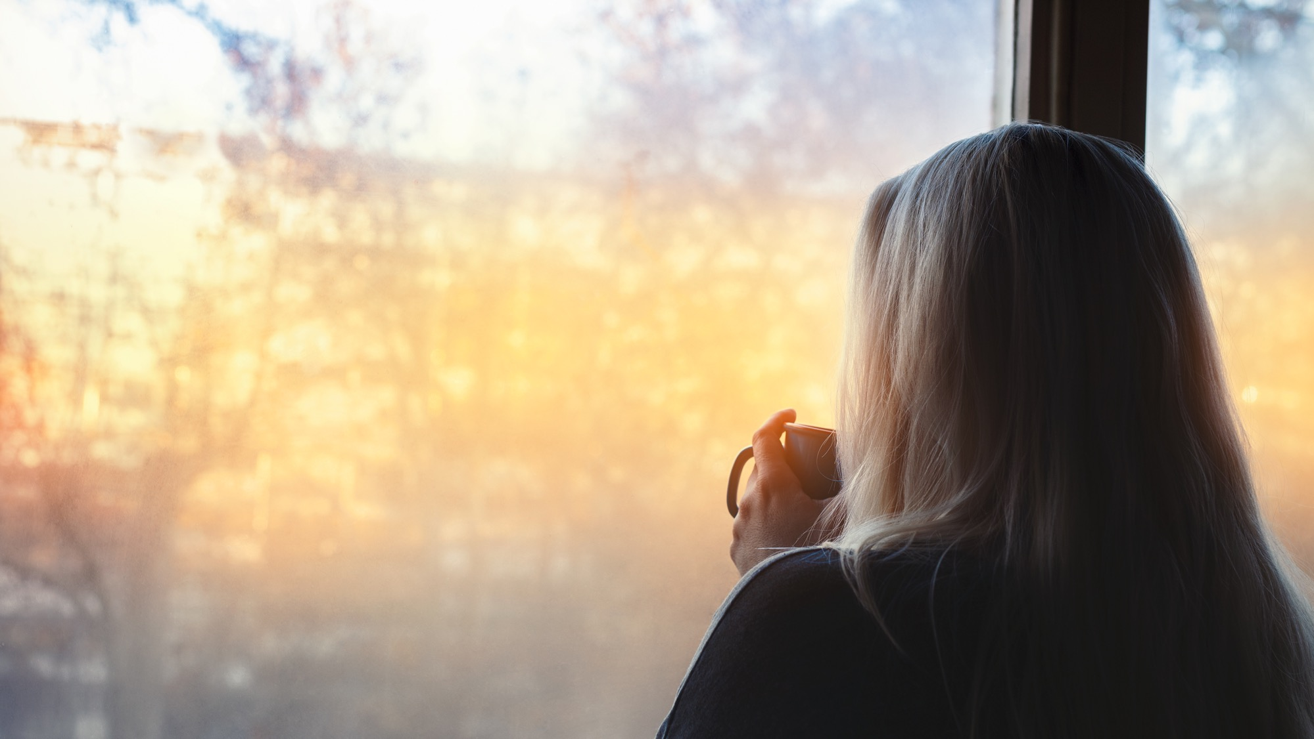
Sometimes in life, we don’t think we can make a difference. We don’t see the effect of our small contribution.
Sometimes the impact can’t be seen straight away, or it takes a long time to see.

Slide 7
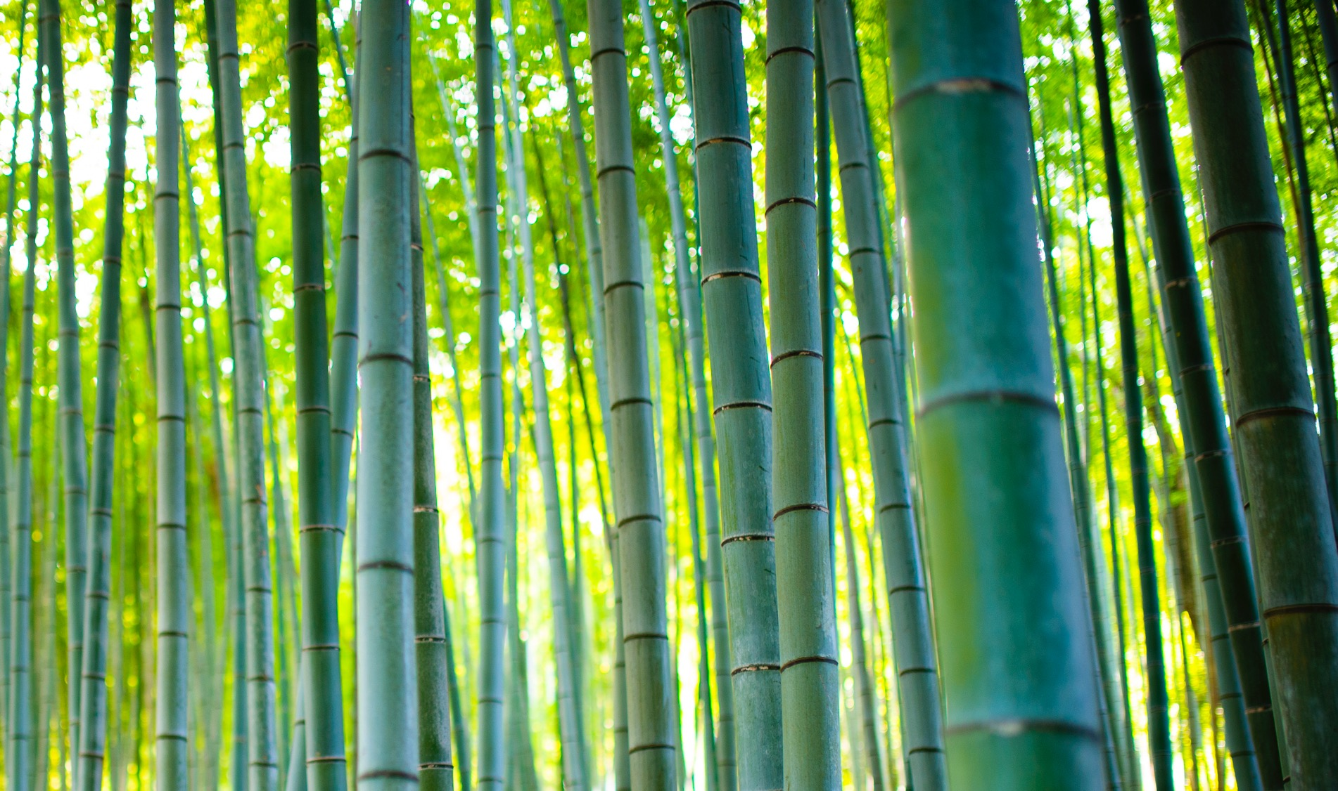
But we are making a difference…
…even if we can’t see it.
Did you know that bamboo roots grow silently for months and then suddenly, within about six weeks, it shoots up really quickly.
You might have thought that nothing was growing, but it was. We just couldn’t see it.

Slide 8
All that we are doing now may seem invisible. Sometimes we might even think it’s not working…
…but if we continue, we will see the fruit of what we are doing now.

Slide 9
It’s the same with most things in life - each day you work hard but may not see a difference in your grades. Each day you physically grow, but may not feel or be that much taller. BUT, over time, changes are happening.

Slide 10
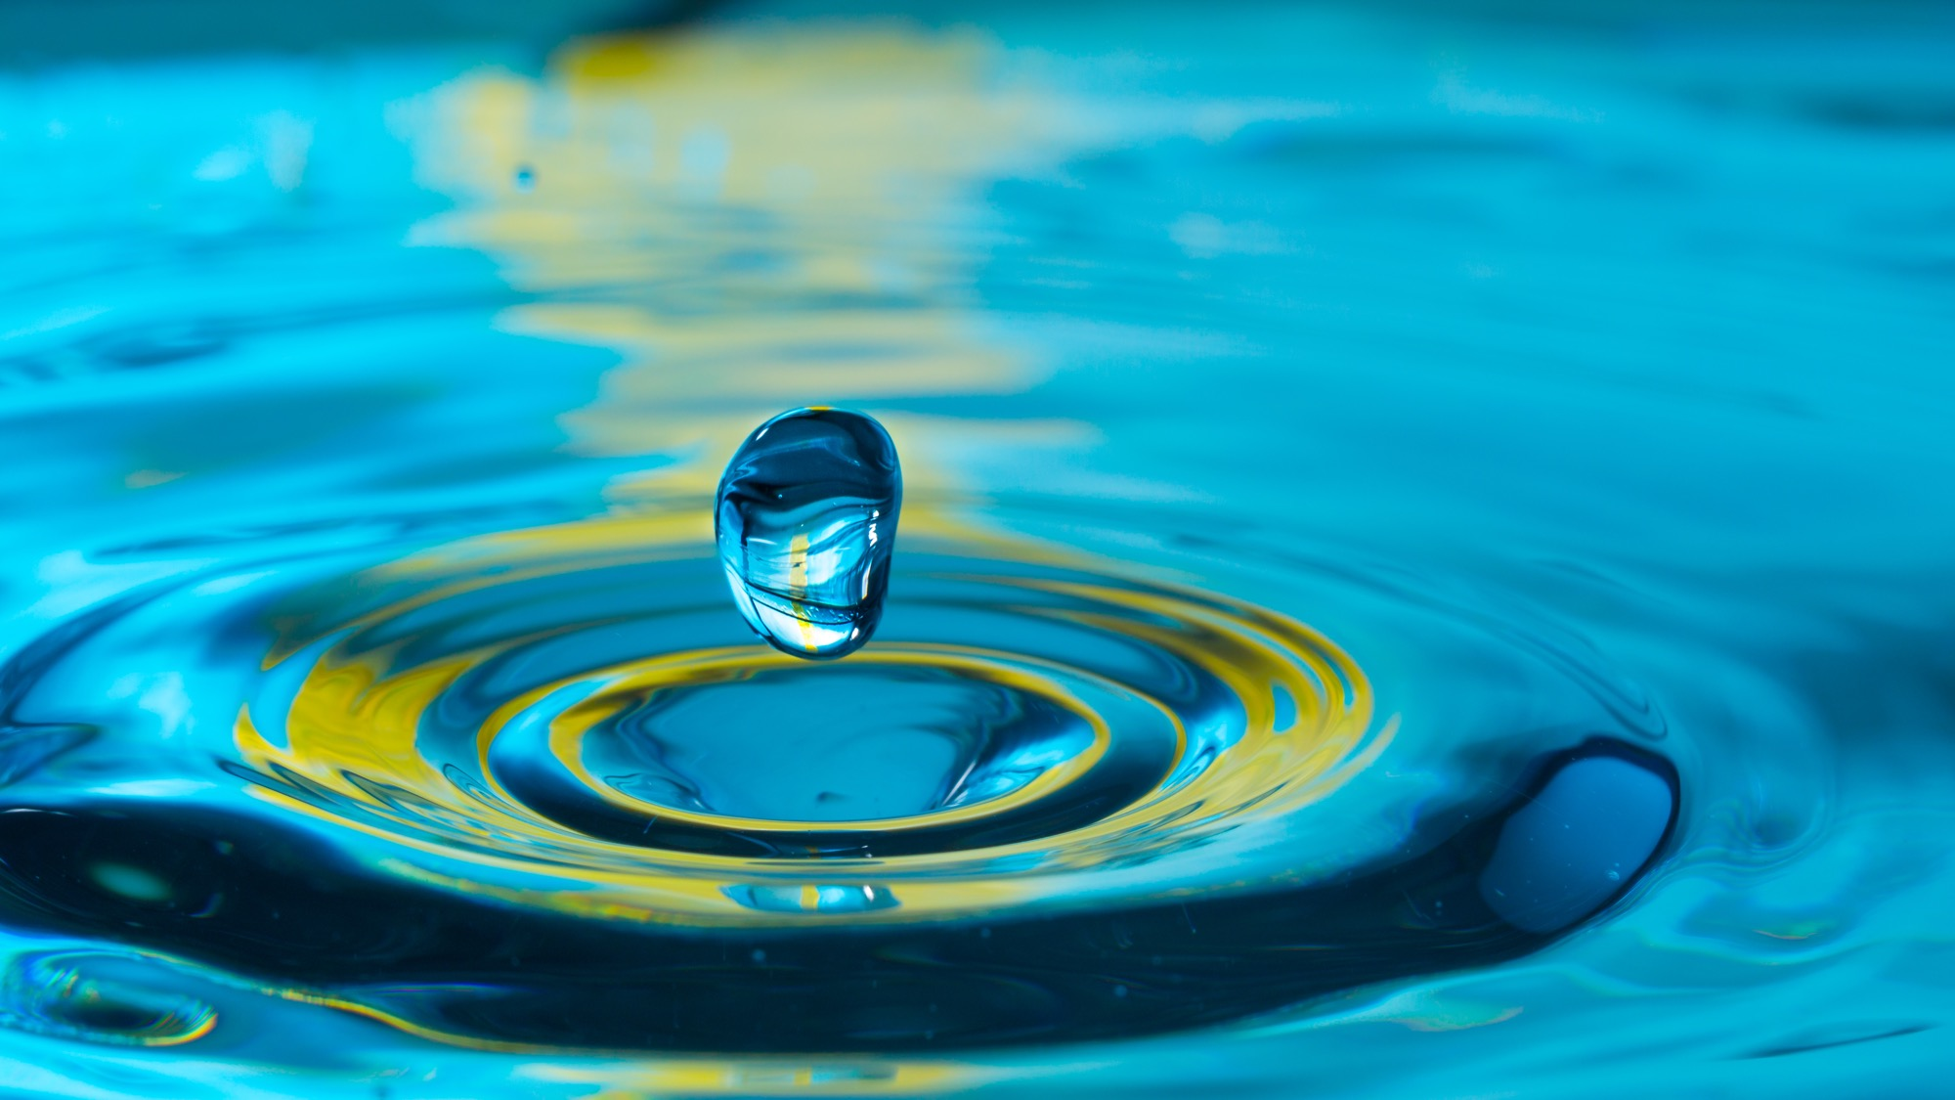
Small changes make a big impact.
We may not see it straight away but what we are doing now will help to save thousands of lives.

Slide 11
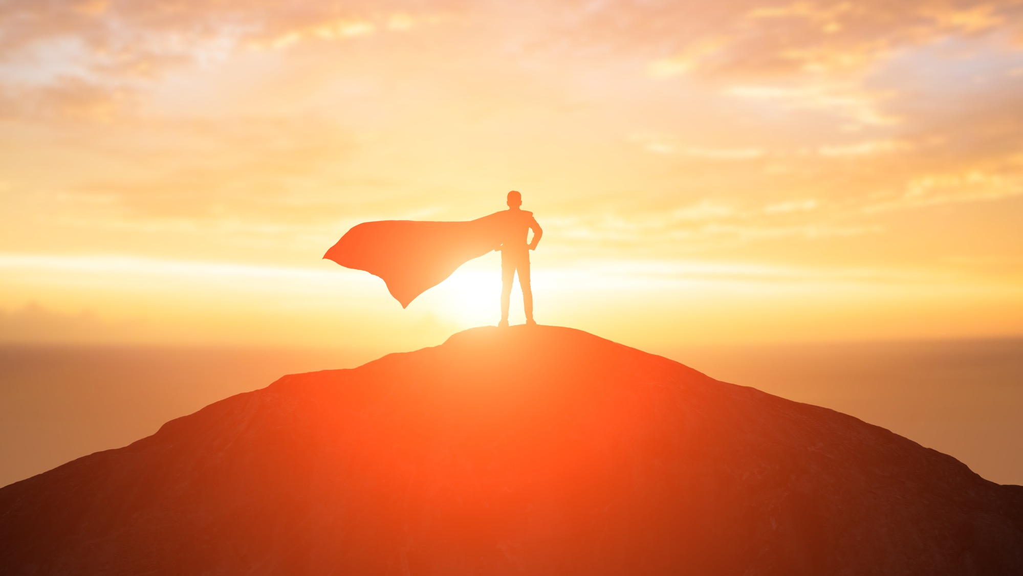
now is the time!
If you ever wanted to be a real-life hero…

