Slide 1
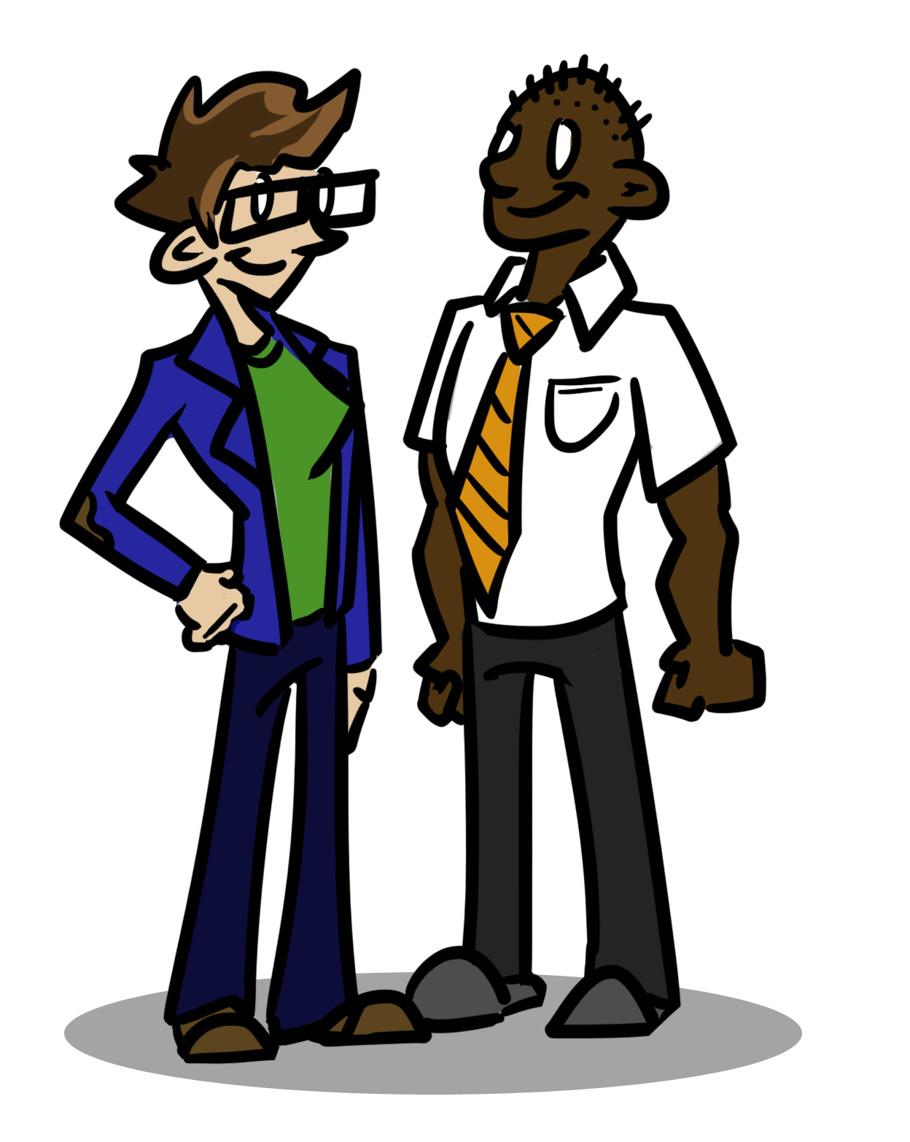
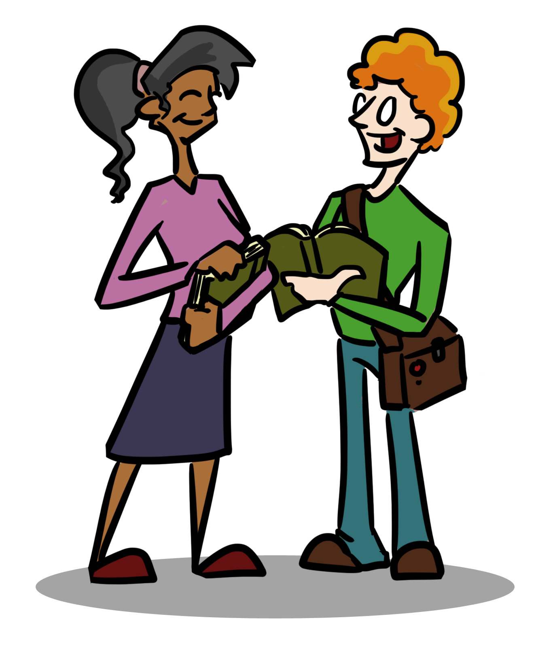
Lesson 6
Working with your teachers…..

Slide 2
The FIRST thing to remember…
Think about this:
Sixth Form is something that you have chosen to do (or maybe you couldn’t think of anything else to do after Year 11!).
It’s a great opportunity to develop those skills that will take you through to university / apprenticeship / career.
When things feel difficult, or challenging just think about your ultimate goal! Go back to your mindmap.

Slide 3
Develop a positive working relationship with your teachers.
https://www.youtube.com/watch?v=RQZcXCDr4Wc (1950s classroom, American, but that doesn’t matter!)
https://www.youtube.com/watch?v=SFnMTHhKdkw (A TED talk…)
As you watch the second video note down Rita’s comments about teacher / student relationships.
How do the approaches of these two teachers differ?
Let’s flip things around: what can students learn from this video about working with their teachers?
Notes:
Watch the videos. Only need a couple of minutes from the first), pausing to discuss the attitude of the teacher in video one and the differences in video 2. Video 2 is 7m 48 seconds – probably enough to watch the first 5. How do their attitudes differ?

Slide 4
What makes a good lesson?
In pairs or trios: have five minutes to discuss what makes a good lesson; agree upon your top five factors. Rank these in order of importance.
Which of these factors are dependent upon the teacher?
Three minute discussion in pairs / trios again – how can the students ensure that they contribute to making a lesson good? Decide upon five things.
Notes:
For the first bullet point anticipating that students will decide upon factors such as: teacher knows their subject, lesson well planned, good discipline (!), work has been marked, students are listened to…

Slide 5
Practical things you can do.
Be PROACTIVE
Use your teachers to help you make progress
In lessons:
Ask questions; if you don’t understand something simply ask. If you don’t yet feel confident to ask in class ask at the end or e-mail.
When work is returned, yes, feel good about what you’ve done well. BUT search out the things that you haven’t nailed yet – and sort it!
Use your Smith Proformas and PLCs – start the process of being responsible for your own learning! Don’t be a passive learner!
Notes:
Quick discussion – what’s the difference between being proactive and reactive?

Slide 6
Reviews with your teachers.
Now you’re in sixth form you are likely to have reviews with your teachers about your progress.
Use these! Come to the meetings prepared!
What concerns do you have? What are you stuck on?
Be honest – no excuses, just look for solutions.
Ask what you can do to improve your grade in the next half term.

Slide 7
What’s next?
Go back to the five things you identified as things you can do to get the most out of lessons.
For the next half term focus on developing these attributes; think about each subject in turn and decide what you can do to get the most out of each lesson. Share this with your tutor.
Review the impact you think this strategy has had by half term.

