Slide 1
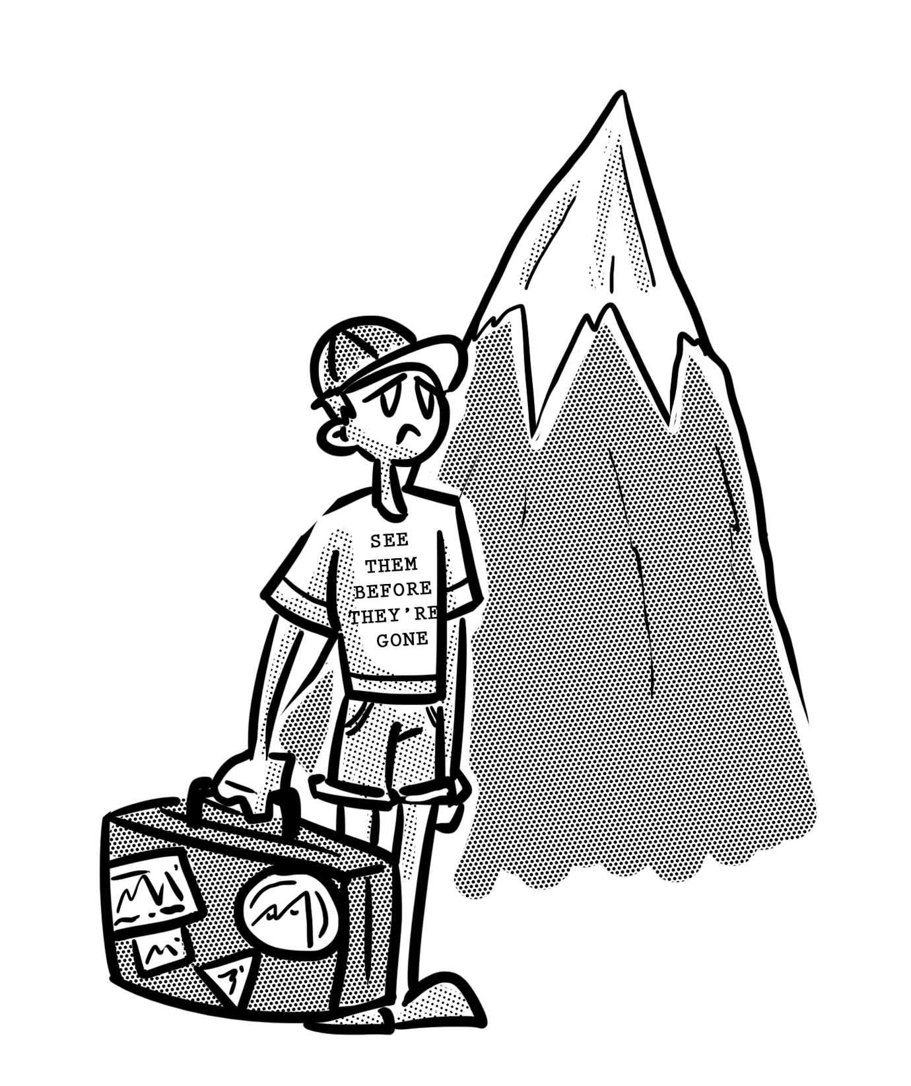
Lesson 5
Resilience and Growth Mindset

Slide 2
So, how are things going….?
You are about five weeks into Year 12.
Still really excited? Any worries or concerns about your work?
In pairs or trios spend five minutes discussing what is going well, and any concerns that you have. For example, you’re really enjoying lessons, but the amount of work you have to do is MASSIVE!

Slide 3
What are our concerns?
There is too much to learn!
I have too much homework!
All the deadlines seem to be the same.
I’ve started to get my first pieces of work back and the grades are rubbish; I’m never going to achieve my target grade!
I’m not sure that I can cope with all the work.
I don’t want to ask questions in class in case I seem stupid.
Everyone else seems to be coping – is it only me?

Slide 4
Back in your groups for 5 minutes.
Firstly, following our whole group discussion see if there are any other concerns that you want to add.
Next: each of you choose a concern that you have. Your partner (s) offer a solution that they think will help you deal with the issue.
Make a list of all of the solutions as you go as you will be feeding these back to the whole class at the end of the activity.
Notes:
Consider making a problem / solution display.

Slide 5
How do you deal with this?
Einstein said: (PICTURE OF EINSTEIN??)
‘Insanity is doing the same thing over and over again and expecting different results’.
Some possible solutions:
Complete a PiXL Knowledge sheet for the topic that’s causing you problems.
Highlight the areas of the essay / piece of work that are inaccurate or need development. Focus on understanding these points.
Put all of your deadlines on an electronic calendar. Set up alerts for when you should be starting each piece of work so that you meet the deadline.

Slide 6
What about your MINDSET?
Growth
Mindset
Fixed
Mindset
I can’t do it YET
I can’t do it
Notes:
How important is having a growth mindset?

Slide 7
What does Matthew Syed say?
https://www.youtube.com/watch?v=sTQaehbNmXQ
As you listen to Matthew Syed write down the positive impacts of having a Growth Mindset.
With your partner(s) decide upon THREE things YOU are going to do to do to improve – this could be your organisation, how you deal with getting a piece of homework back…you choose!
Notes:
Challenging language in the video, but the key message is clear.
Matthew Syed – Olympian, sports journalist, author of Black Box Thinking and Bounce

