Slide 1
Lesson 4
Study skills

Slide 2

Speed dating
You have been split into two groups A and B
Person A will do all the talking first, Person B must listen and take notes
For 30 seconds person A is going to tell you everything they know about………….

Slide 3
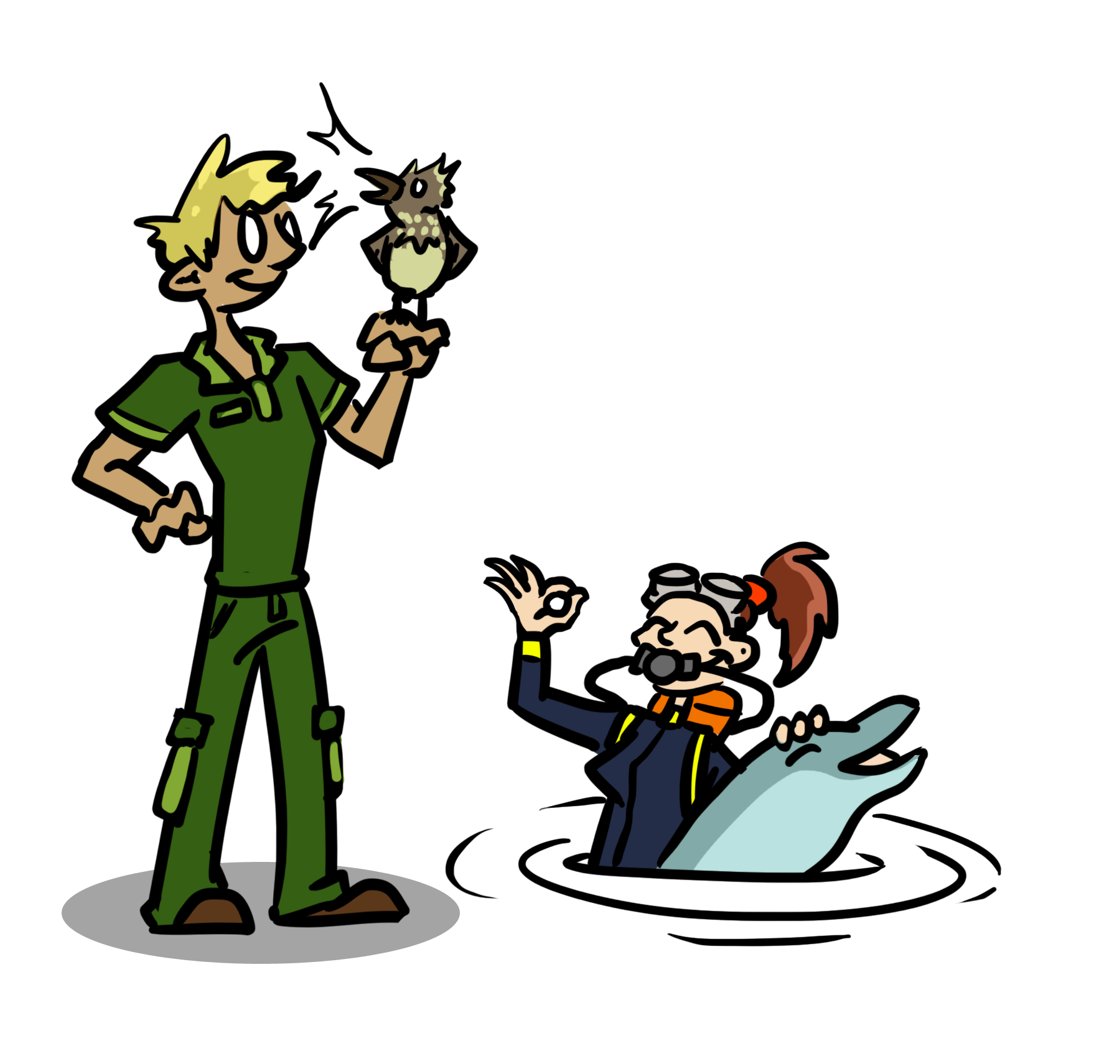
Owls and Dolphins!

Slide 4
Double date!
Find another pair, this time Person A in each pair has to stay quiet. B’s will take it in turns to tell the other couple what they have learnt from their partner.
Person A, listen carefully how close are they to what you said?

Slide 5
Swap partner!
Now repeat but for 1 MINUTE Person B is going to talk to their partner about ……
THE SUBJECTS YOU HAVE CHOSEN AT A LEVEL AND WHY

Slide 6
Why do we need to listen?
We need to be able to listen as well as speak.
Taking effective notes in class and being able to reference back to those notes is often a new skill in Sixth Form.

Slide 7
Read All About It!
You will be given a newspaper article to read. You must pick out the 10 KEY points from the article and write them on individual bits of paper
Compare your notes with another group, do you agree? Would you be able to explain the article to someone using only your 10 key points?
Notes:
Pick any article from this weeks news, it might be an idea to have a couple of articles and get groups to do different ones and then try and understand the article from just the key points

Slide 8
Extension
https://ed.ted.com/featured/PP00zCty
Watch then carry out the think, dig deeper discuss
What makes a successful student
How to speak so that people want to listen
https://www.ted.com/talks/julian_treasure_how_to_speak_so_that_people_want_to_listen
Notes:
This often terrifies people but is there a way you could develop this skill?
Have you used the LORIC materials?
What about PiXL Orate?
Can you find an opportunity to work with some younger pupils and speak to them?

