Slide 1
Lesson 2
Creating your own roadmap

Slide 2
20 Years from now…
Listen to the lyrics in the song
https://www.youtube.com/watch?v=sTJ7AzBIJoI
What are YOUR goals and ambitions?
What would you like to be doing in 20 years time?
Interestingly this song IS now over 20 years old!!

Slide 3
Log book
You are going to keep a log book of all the activities and tasks you carry out in order to build a picture of YOU.
Refer back to the ‘Ideal Learner’ what have you already done to help you achieve this?

Slide 4
I want to volunteer
What should I do now?
How do you decide?
Pick something you are passionate about- Sport, working with children/ animals, literacy.
Look for something different. There are lots of opportunities but sometimes thinking a bit creatively about your personality and skills might open doors you had never thought of before.
Use websites like… https://do-it.org/
https://www.ncvo.org.uk/ncvo-volunteering/i-want-to-volunteer

Slide 5
Talk to friends and family. There's nothing like tapping into the resources already available to you. Is there someone you know that could offer you work experience? Does your school use peer mentors? In class support for younger pupils?
Consider how the organisation might support you in your future aspirations and plans. Some even offer training opportunities.
Can you use the work experience to develop a particular skill you already have- if you are perusing languages for example are there any opportunities to do some translation work.

Slide 6
What do I have to offer?
Identify your skills- write down your top 10 skills and positive personality traits. Then look to match these with
Be realistic with your time- How much time are you prepared to spend volunteering/ working?
How long are you prepared to volunteer for? This will impact on the type of organisation you look to work for.
Treat the application process seriously. This is a place of work and you need to treat it as such.
Keep a log in your log book of anything you do, maybe try keeping a diary as you go to remind yourself of what you have done. Focus on skills you have used and situations you found yourself in.

Slide 7

Where Next?
Deciding what to do after Sixth Form is daunting and many of you will change your mind multiple times. SO lets start with something easier…
How far is it to travel?
List 5 places you might want to visit as potential university locations or areas you want to seek work. Now investigate HOW you get there using public transport, some places might surprise you!!
How much would the journey cost to visit home?
Are there restrictions on a weekend?
Is there somewhere a bit further that is easier to get to?
Notes:
Consider having a big map in your classroom where students can refer to and think about how to get to the various places. Talk to your MATHS dept about places for the large data set!

Slide 8
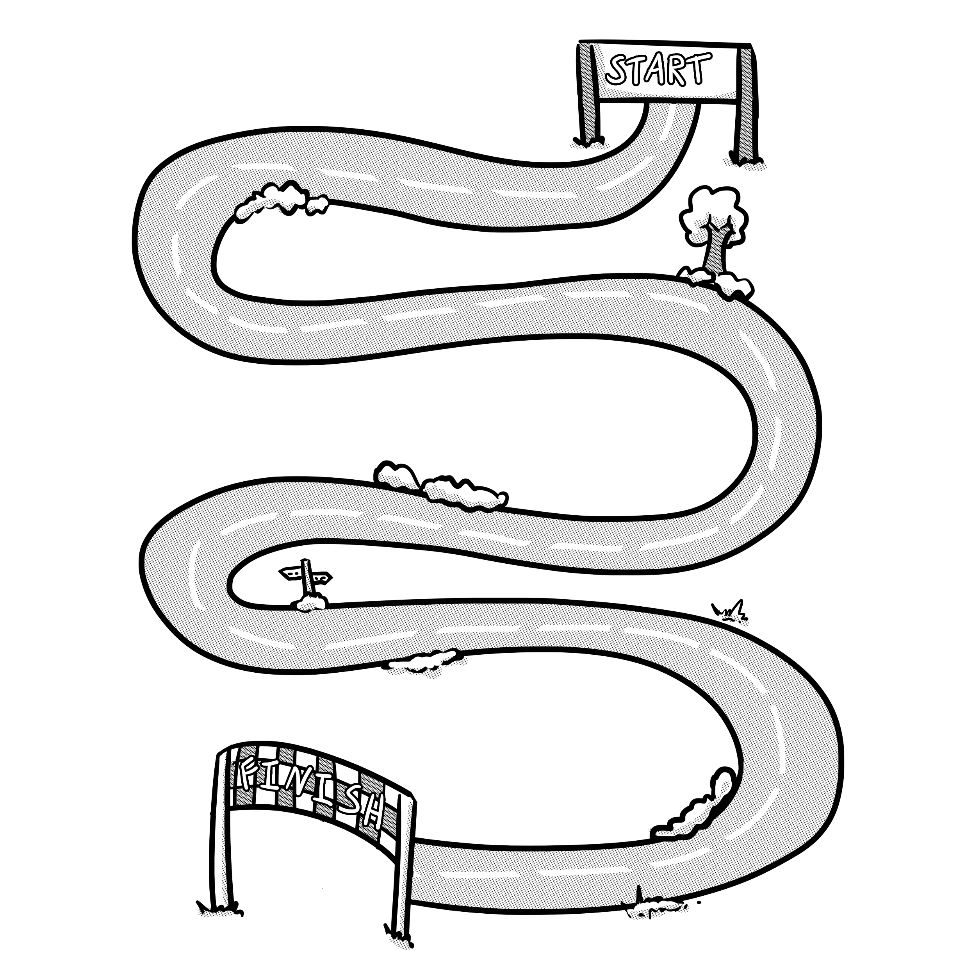

Open days/ visits
Put key dates on your road map.
Have a class calendar on the notice board, if you find out about an open day/ visit opportunity add it to the class calendar so everyone can see it and go if appropriate.

