Slide 1
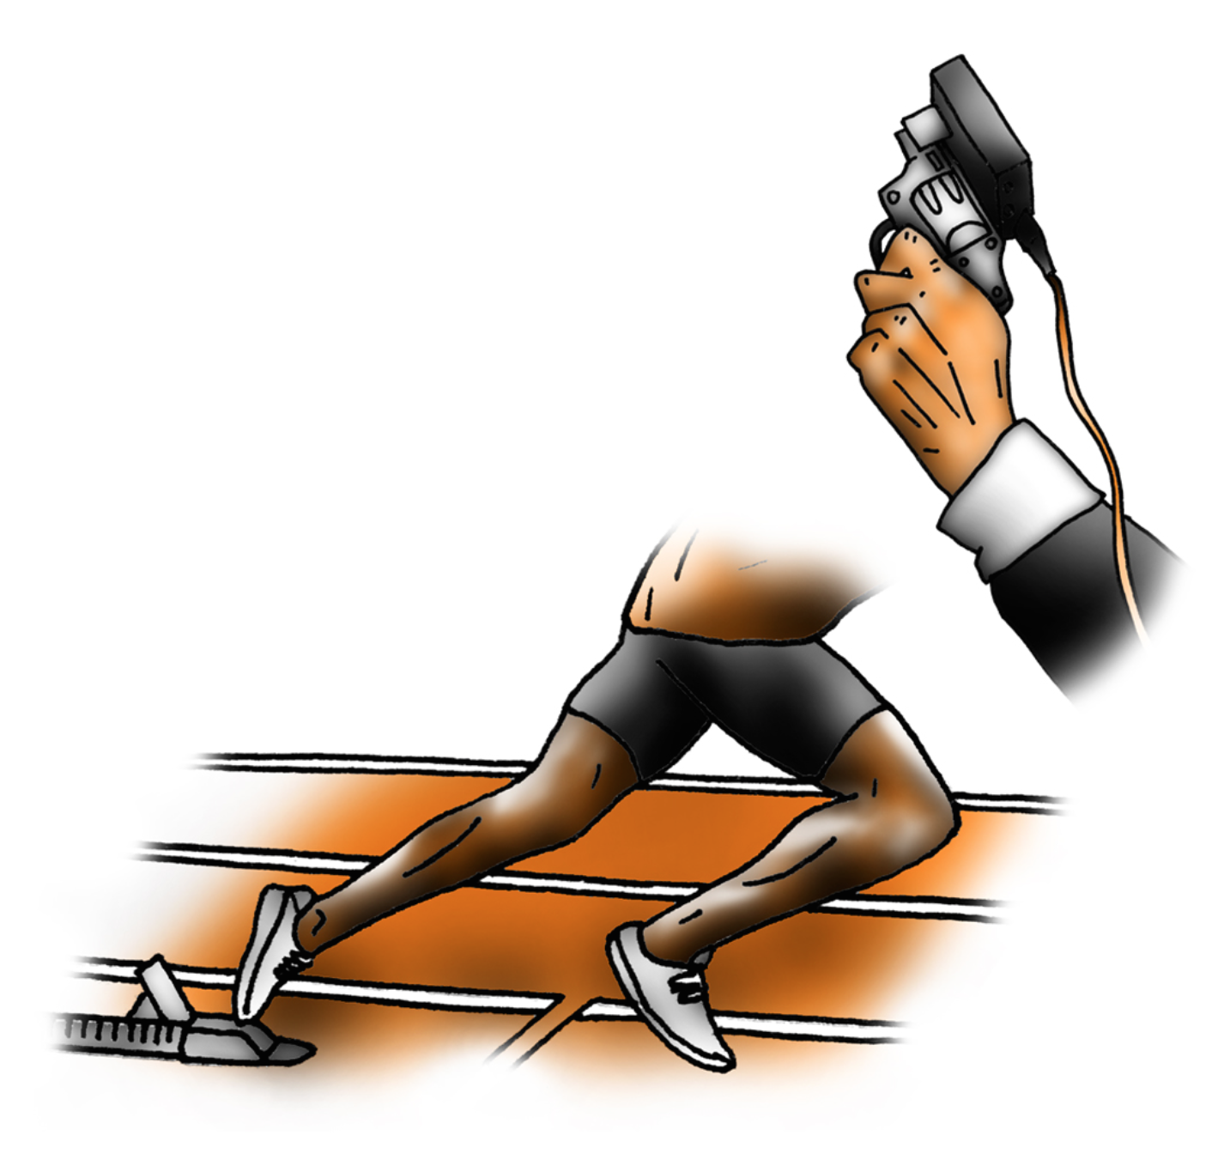
Lesson 1
Starting your post-16 journey

Slide 2
Reflect on how far you have come
Firstly, WELL DONE!
You have been part of a hugely challenging part of history, but you made it.
Don’t underestimate how amazing you are and how much the last 12 months will have shaped the person you are today.

Slide 3
Reflect on how far you have come
You are now about to start the next exciting chapter of your future.
What will it look like? What do you want to achieve?

Slide 4
What you have achieved
Do not underestimate how much you have grown over the last year:
Improved organisation skills
Self-motivation
Self-discipline
Using IT and social media to stay connected, like never before
How else have you grown?

Slide 5
Reflect on how far you have come
How did you learn most effectively in your lessons?
Do you think that you improved from the beginning of Year 10 to the end of Year 11? If so, how?
What was good about your personal organisation? Any lessons to be learnt that you can take into your sixth form studies?
How well did you cope with the periods of change and challenge?
What do you want to keep about your behaviour from the last year?
What do you want to change?

Slide 6
Ideal Learner
In pairs/groups, write down all the things which you think describe the ideal learner:
What qualities would they have?
What would they achieve?
How do they present themselves?

Slide 7
Wordle
Now, in your groups, pick your top 3.
Discuss in class: Have you got a consensus?
Create a ‘wordle’ http://www.wordle.net/
Have this up in your classroom – THIS IS YOUR COLLECTIVE GOAL.

Slide 8
“To my future self”
Write a letter to your future self with advice on what you wish you had done differently in Year 11. What would you like to hear when you open the letter 18 months from now?
Use the link below to automatically send yourself the letter in 18 months time!
https://www.futureme.org/?utm_expid=.xfbSl_PQSt6vPqeI1K8Bug.0&utm_referrer=

Slide 9
Back to the Future
With a partner, talk about any future plans you might already have. While your partner is talking, write down any words that spring to mind.
Be aspirational!
Be honest!
Be excited!

