Slide 1
Reflections
5: Connectivity

Slide 2
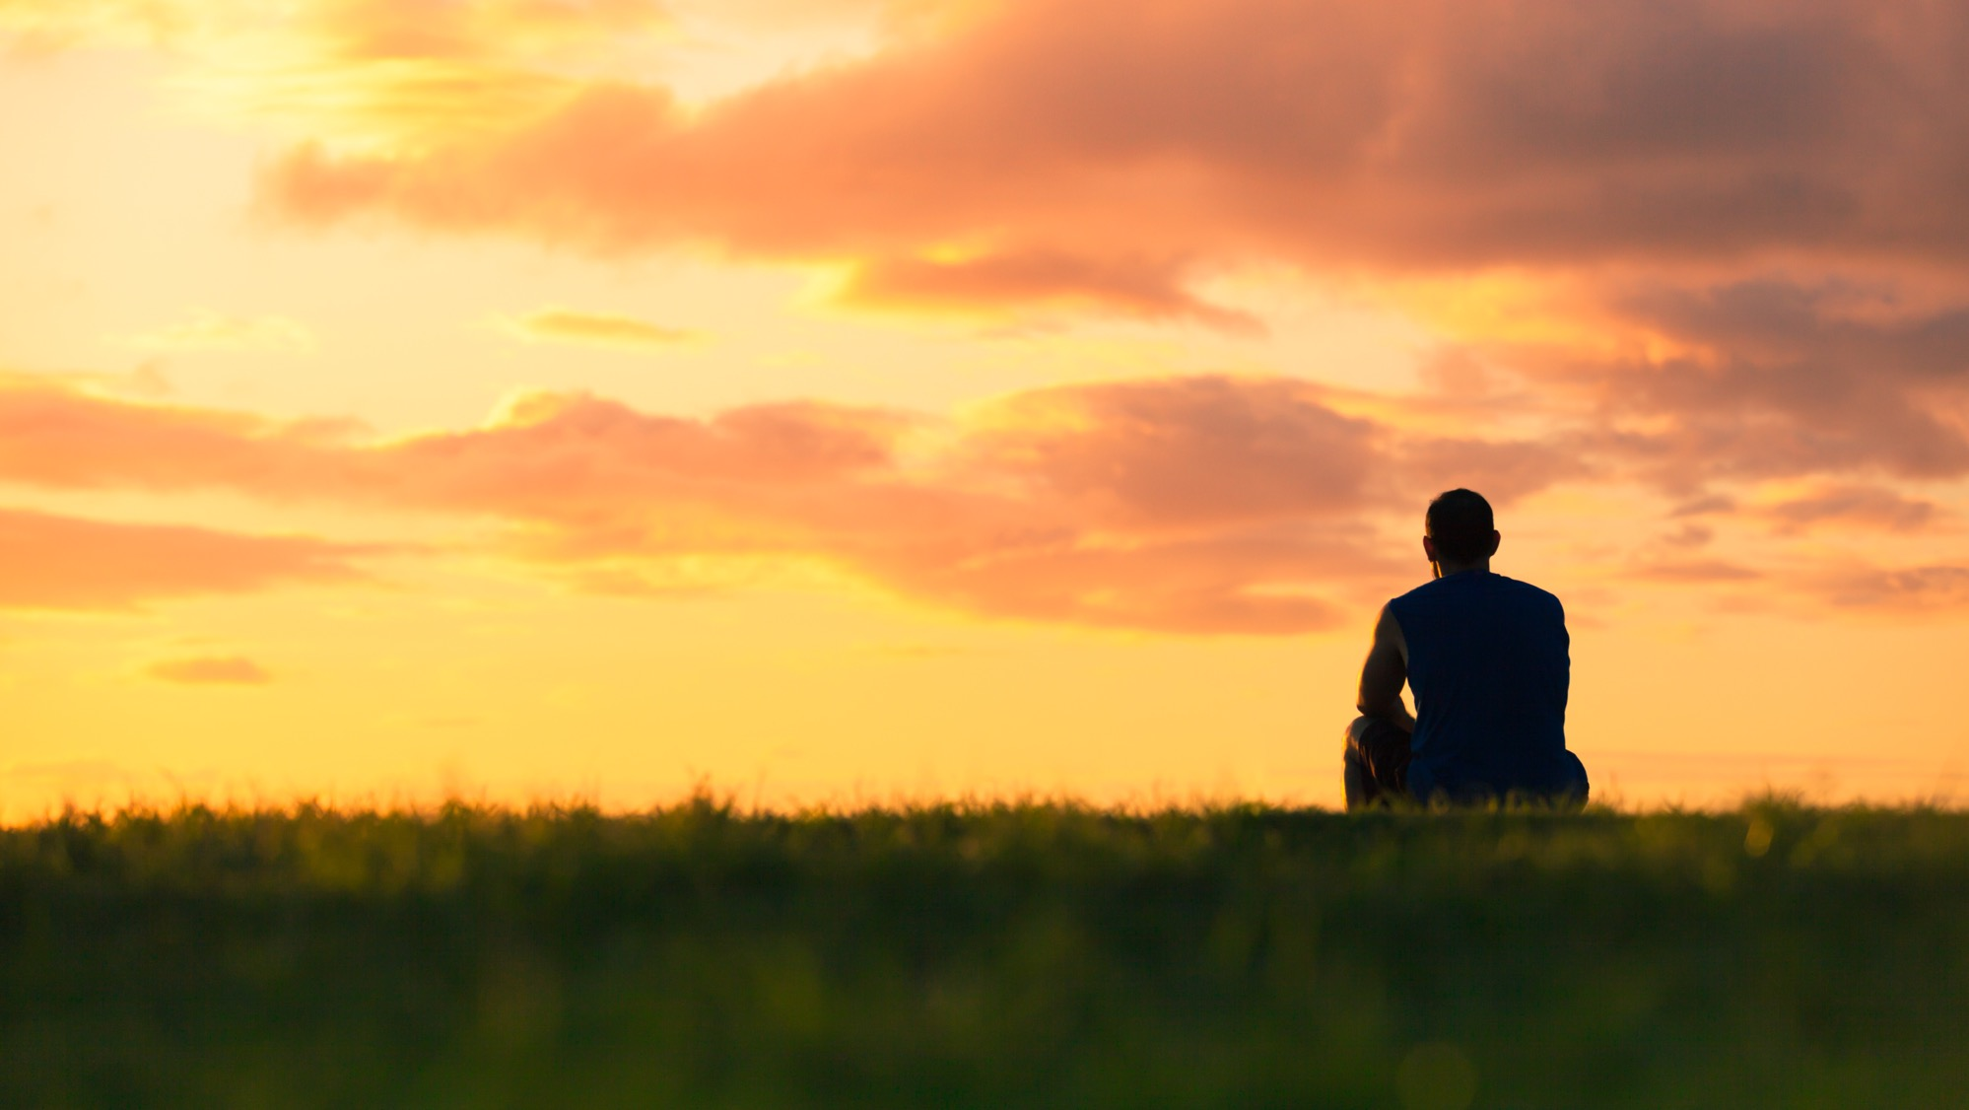
In these strange times, it is easy for people to feel alone.

Slide 3

One of the wonderful things about human beings is the creativity and innovation people bring to problems.

Slide 4

We know that all theatres have closed and yet people are making the shows appear online.
Producer Jamie Hendry is making the Stiles and Drewe musical version of The Wind in the Willows available for free as a digital production, via:
www.willowsmusical.com.

Slide 5

Concerts and gigs have been cancelled and yet artists are still working together to bring us music…
Gary Barlow’s Crooner session:
https://www.youtube.com/watch?v=_2a_9JpJiaA

Slide 6
We even have choirs, bands and celebrities who are meeting online and singing together…
Gal Gadot lead a star-studded sing along to ‘Imagine’:
https://www.youtube.com/watch?v=4sFLqGfSnVQ

Slide 7

TV shows like Ant and Dec’s Saturday Night Takeaway and the One Show have found ways of engaging with presenters and a studio audience when they are all at home.

Slide 8
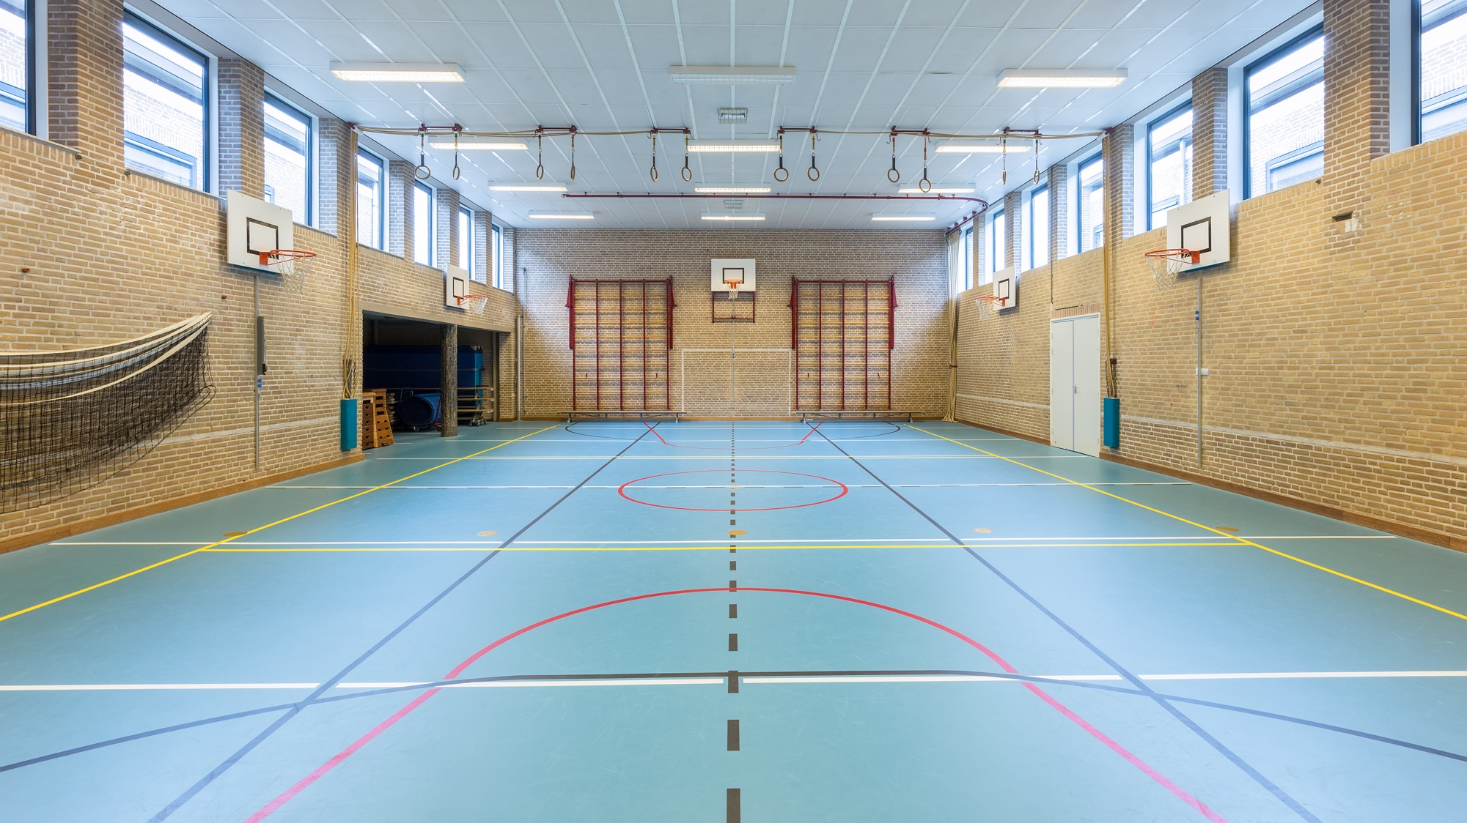
Joe Wicks had a million people doing PE from their homes, perhaps you were one of them?
https://www.youtube.com/watch?v=Rz0go1pTda8

Slide 9
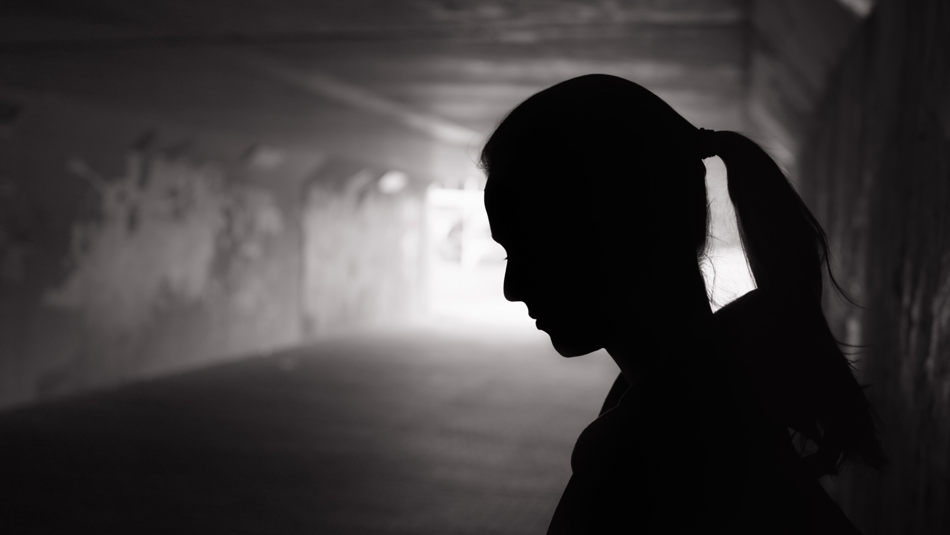
Just because we have to stay in or be socially distant, it does not mean that we have to be distant in our connections.

Slide 10
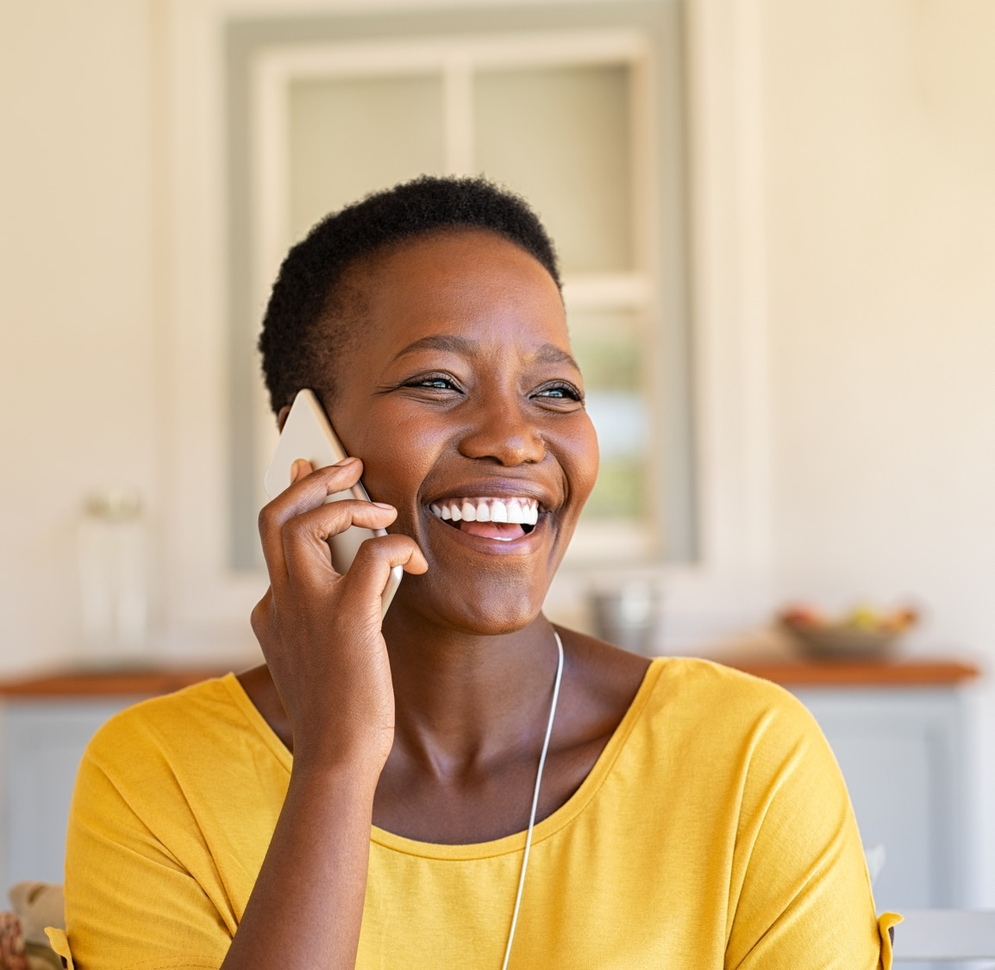
All of us can reach out and be part of a community, enhancing each other and helping us feel less isolated.

Slide 11

Perhaps you could engage in some things you have never done before and learn about the world around you.

Slide 12

Use this time to connect to people who may have different interests to you and be part of the global community.

