Slide 1
Reflections
4: Community

Slide 2
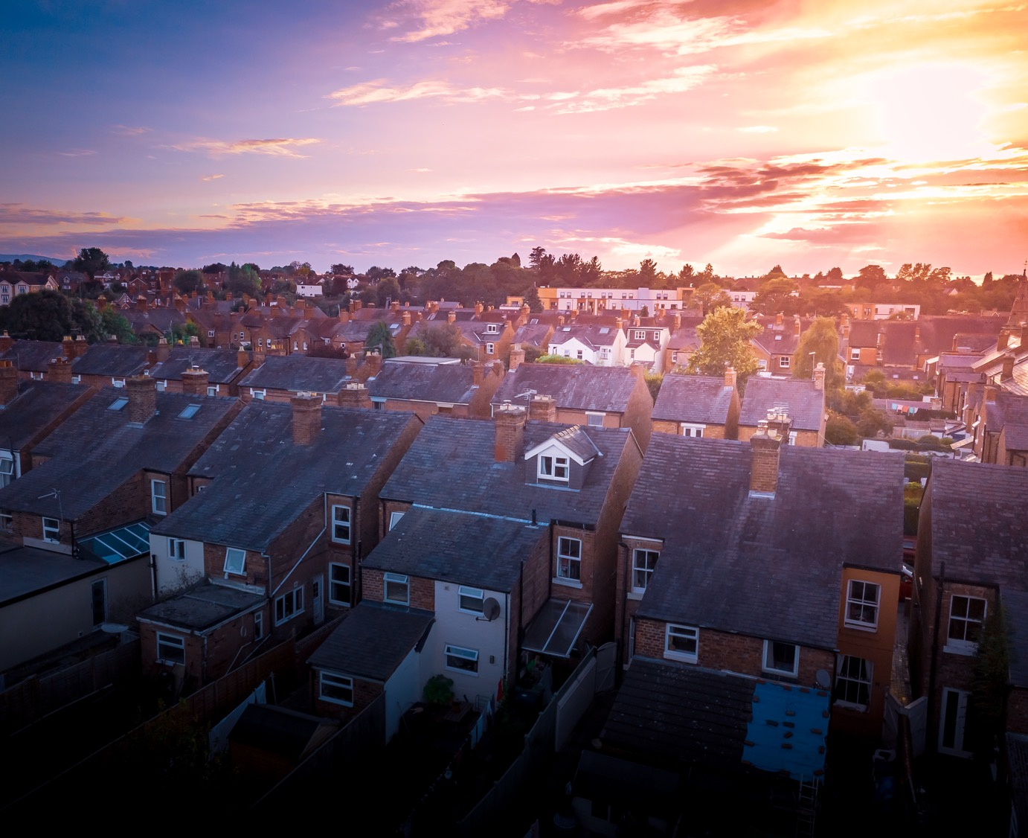
We are part of a community, a society and now we are all facing the same things together.

Slide 3
In our world, there has often been a focus on I and me, instead of ‘we’. Sometimes we have become selfish or isolated. Many in our society feel lonely.
We have much more impact if we work together.

Slide 4
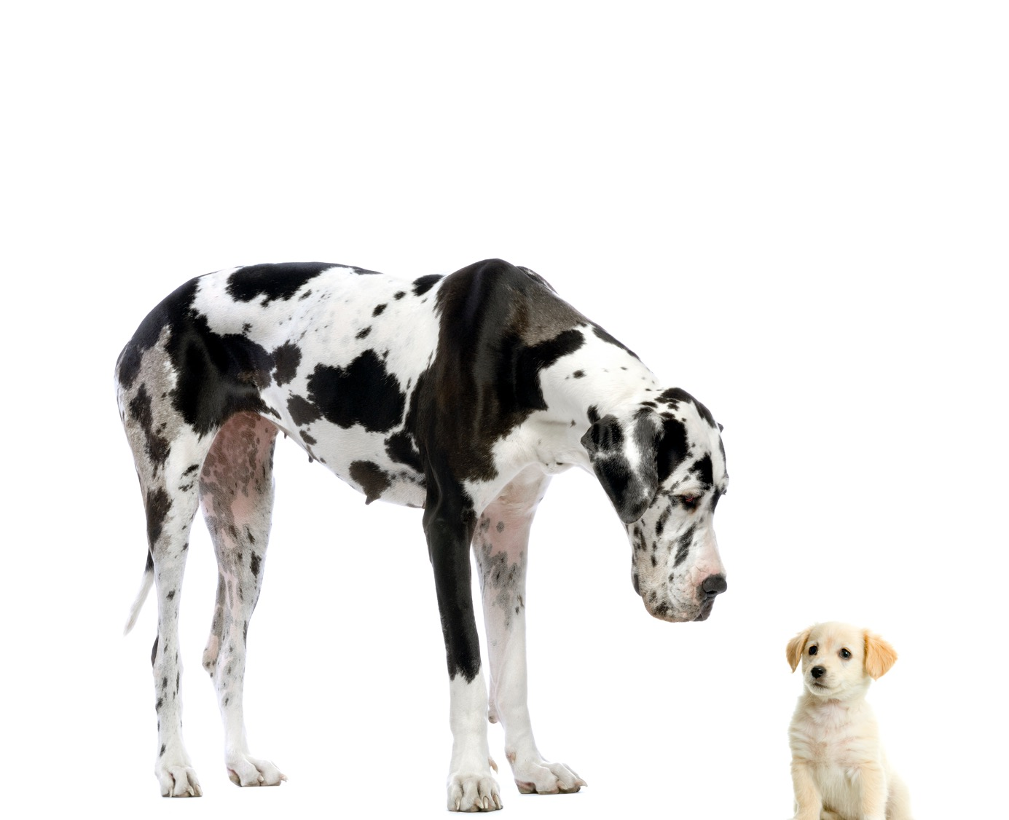
Each of us has a part to play, even if we think it is small.

Slide 5
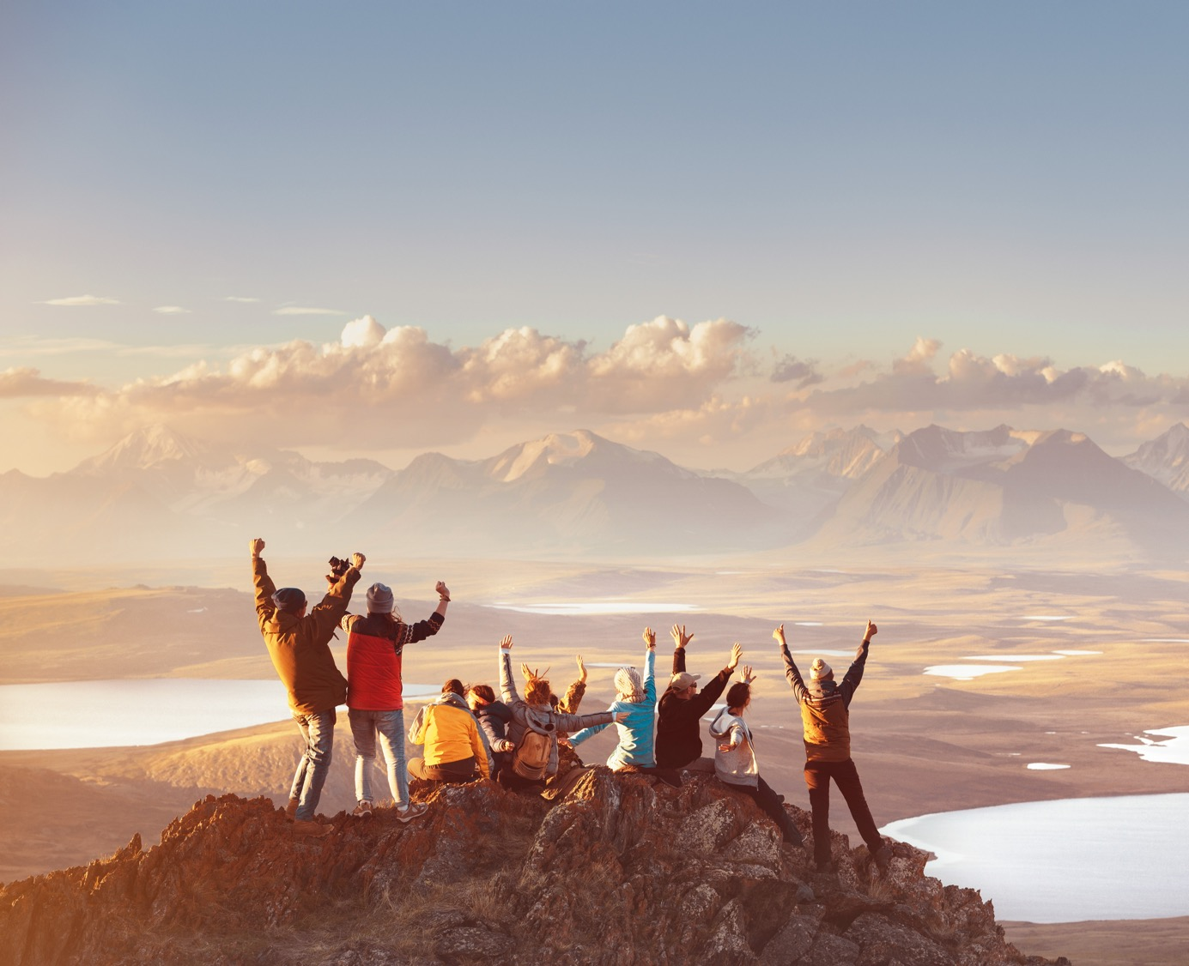
Amazing things can happen, if we work together.

Slide 6
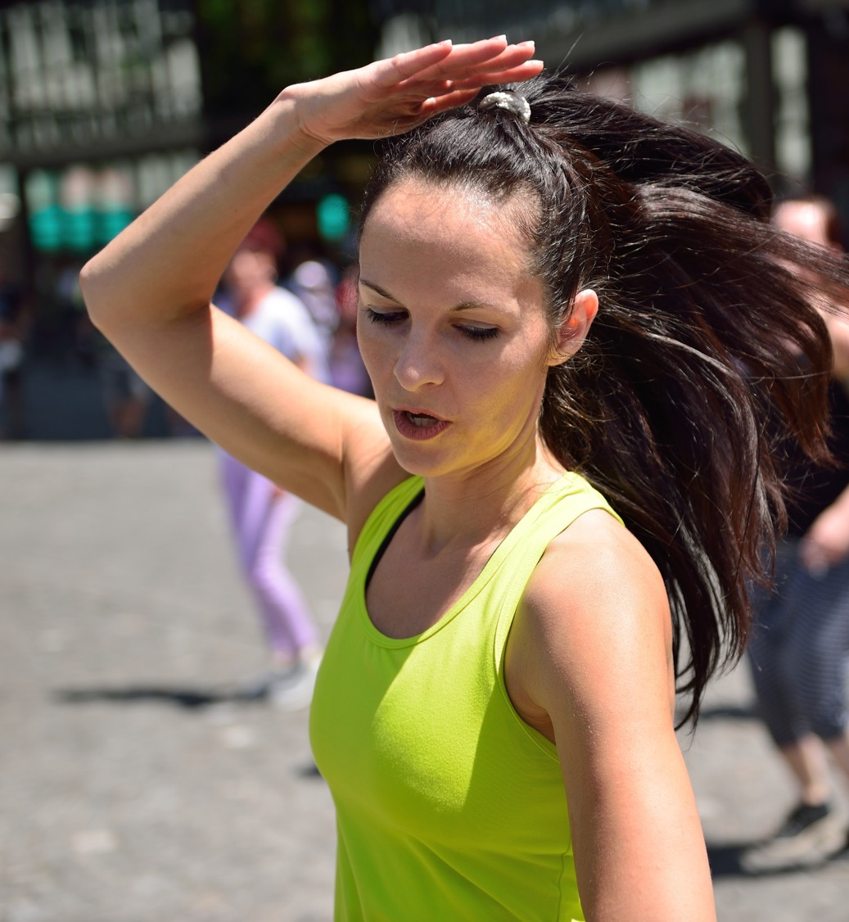
Some of you may have seen how flash mobs work.
One person starts a dance and then, before you know it, the whole place is dancing in time.
The impact of everyone doing their own small moves, in time, is greater than any one contribution.
Click here to see one!

Slide 7
People were made to be together, to work together, to be in community together.

Slide 8
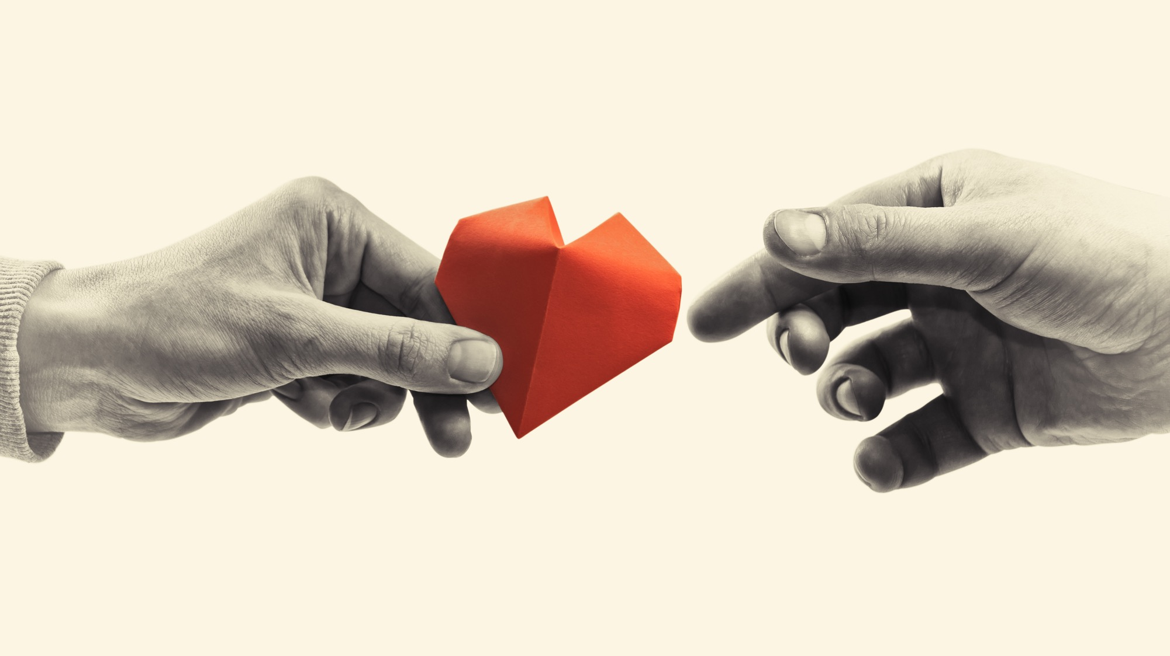
What small thing could you do this week that, if we all do it, could make a difference?
Perhaps you could write to a care home and let the residents know you are thinking about them or a hospital and thank them?
Maybe you could record a video for people who may be on their own.

Slide 9
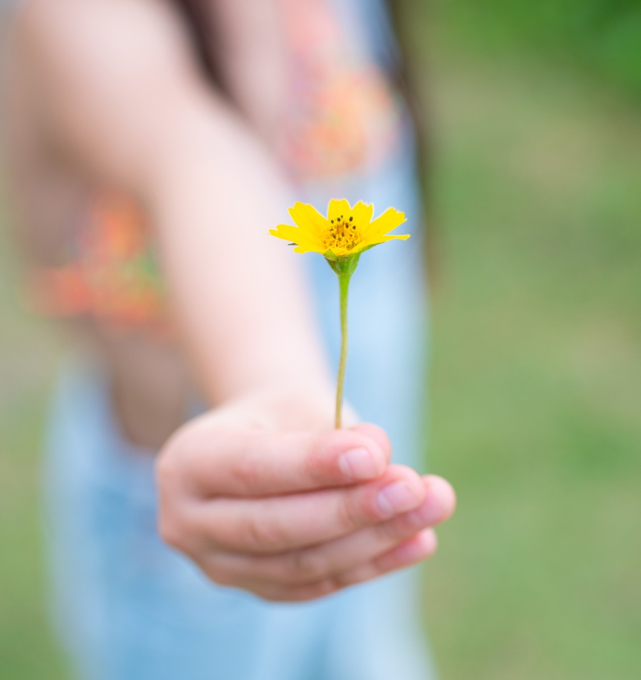
Individual acts of kindness,
if we all do them,
will make a huge difference in our country right now.

