Slide 1
Reflections
9: Chaos – Creating in the space

Slide 2
During this season, we all may be experiencing moments of feeling overwhelmed and a little confined to a box.
Maybe entirely confined to a box.

Slide 3
Many things have been stopped.
We have limited movement and contact with loved ones.
Even our shopping choices are more limited.

Slide 4
These thoughts can be the first things we think of when we explain the ‘chaos’ of this time…
…notice they are negative?

Slide 5
And rightly so, as there are negatives that are coming from this situation.

Slide 6
We must take a moment to remember those who are experiencing health difficulties associated with COVID-19, and Key Workers, and those who now have adverse circumstances to face as a result of this situation.

Slide 7
But… what if amidst it all, we try to use the time to discover something new? About ourselves and the world around us?

Slide 8
In all of this, the one main thing we do have more of is…
time.

Slide 9
Time to get to know that member of the household a little better.
Time for a phone call.
Time to read a book.
Time to learn something new, or to research further into the future career you want.
Time to focus on who you want to be, on the sort of person you want to be.

Slide 10
With time to invest in that…
instead of seeing this time as entirely chaotic, why not see it as ‘disruptive innovation’?

Slide 11
Creation, exploration, new thinking, new skills…

Slide 12
This chaos could be developing your ability to deal with other things in future, or could lead you to discover something that may change your life forever…

Slide 13
Each experience in life, positive or negative, can teach us something if we let it…

Slide 14
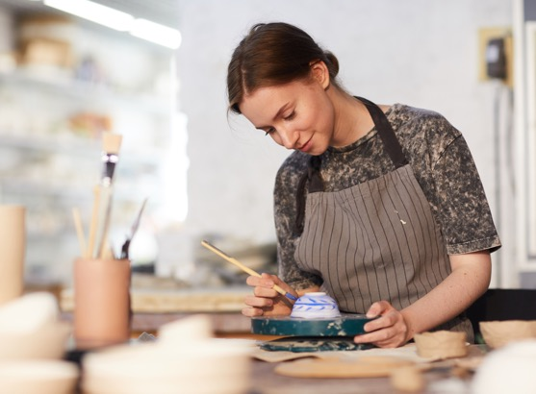
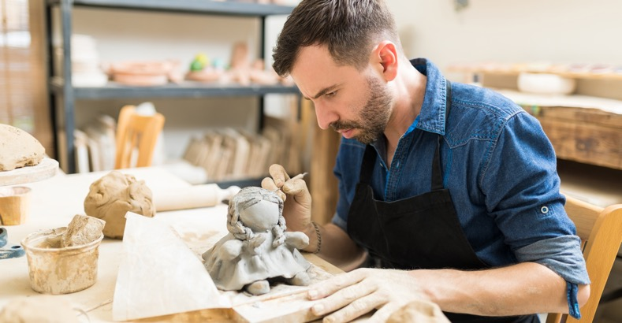
Embrace the opportunity within the chaos…
…because this time will pass.

